Slide 1
Use Cases
Quality Attribute Scenarios
Felix Bachmann

Slide 2

Use Cases vs. Requirements
“We have been working for so long to get all the requirements together. Why should be create Use Cases?”
Requirements are like the trees in the forest. Without them there is no forest!

Slide 3
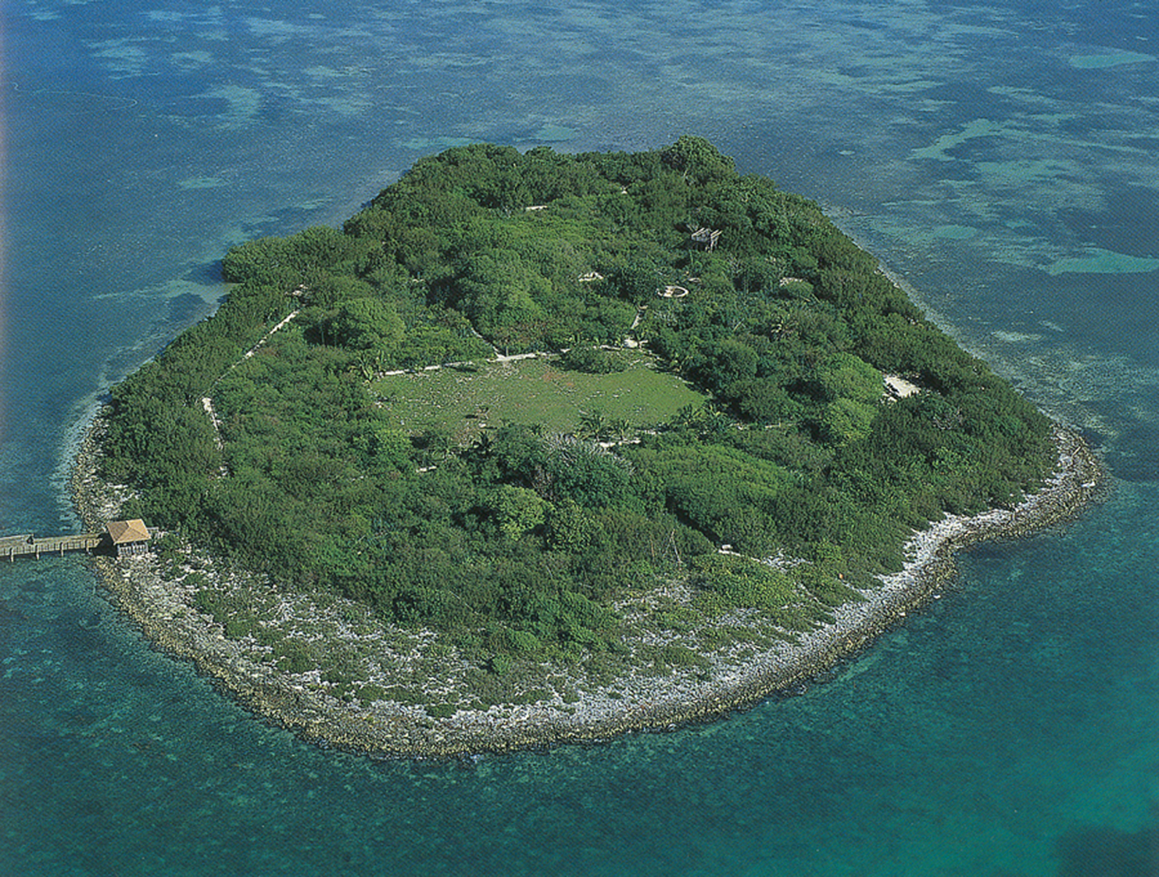
Use Cases vs. Requirements
Requirement documents are a terrible tool to explain someone what a system is supposed to do.
It is like looking at all the trees without an idea about the forest.
The use cases are the attempt to describe the forest – to describe what a user tries to achieve by using the system.
Use cases are a communication tool to explain a users intent – they provide the context in which to interpret the requirements.

Slide 4

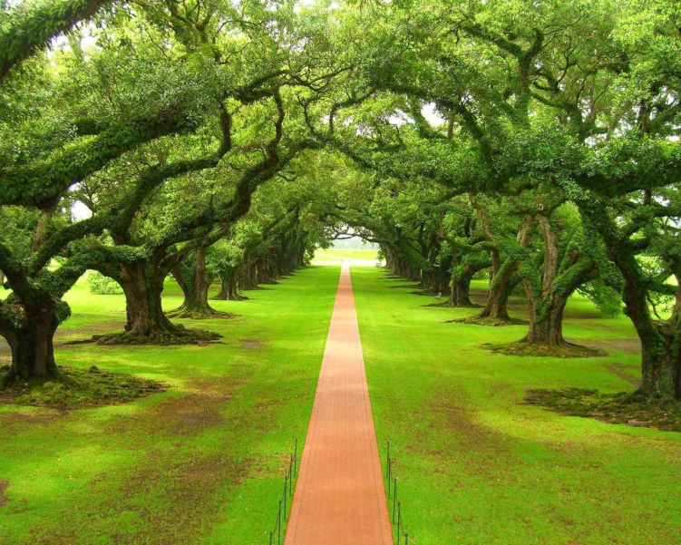

Use Cases vs. Quality Attribute Scenarios
It is not sufficient to describe the functions a user wants to perform.
There are many undocumented assumptions about how well those functions have to perform.
Use cases describe what functions the user wants.
Quality attribute scenarios describe how well the functions have to perform.

Slide 5
System Boundaries
Use cases and quality attribute scenarios refer to a system. We will call that system the target system.
A use case describes the expected functions the target system provides including the interactions from and to this target system.
A quality attribute scenario describes how well that target system reacts to those interactions.

Slide 6


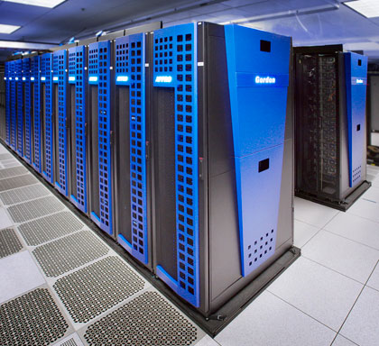

System Boundaries – Context Diagram
To avoid confusion a context diagram is used to describe which is the target system and who (what) is interacting with it.
Informal notation
OR
Formal notation
UML

Slide 7
System – Use Case – Quality Attribute Scenarios
Use Case
Quality Attribute Scenario

Slide 8
Purpose of Use Cases
The purpose of a use case is to describe a function a user will perform using the target system.
A user can be a human user or another system that is connected to the target system.
To make our lives easier we call a human user and those other systems actors.
A use case describes interactions of actors with the target system to perform a function.

Slide 9
Use Cases – How Many?
The purpose of use cases is to provide understanding of the context. They are a communication tool not a full set of requirements.
It is NOT the purpose to describe all possible interactions.
Humans are limited to the amount of information they can comprehend at the same time. Humans are also great in guessing missing information.
To get an idea of function a user will perform using the target system five to ten use cases are sufficient (less is more!).

Slide 10
Use Cases – Level of Details?
A use case treats the target system as a black box. Do not try to tell how the internals of that system are supposed to work
A use case only describes what is observable by an actor.
A use case also describes a future system (or a future feature of an existing system). Therefore, do not describe how the target system works today. Leave it open to the system development to come up with new ideas.
Some use cases have many exceptions from the normal flow. Do not try to describe all of them, describe some of the important exceptions to give an idea about the problems.

Slide 11
Use Case – Information Pieces – 1
A use case should be documented using the following structure:
Identifier – A short identifier to be used in other documents to refer to this use case. The identifier should NOT contain any organizational information, such as 2.3.6.1 which might refer to the hierarchy of use cases in a document
Short description – to be used in other documents (or conversations), to refer to a use case and quickly understand what use case was meant.
Notes:
RTSS Internal Review
5/24/2010

Slide 12
Use Case – Information Pieces – 2
Description – A description of the goal of this use case. It is a summary of what the actor tries to achieve. This should be one or two paragraphs giving a more detailed description to the reader so that it becomes clear what this use case is about.
References – Often there exists other documentation that is interesting or necessary background material for the reader of this use case. Don’t repeat what is already described somewhere else!
Prerequisites – often a use case only makes sense if a specific condition is achieved prior to executing the use case, e.g. user must have been successfully logged in.
Notes:
RTSS Internal Review
5/24/2010

Slide 13
Use Case – Information Pieces – 3
Steps – This is the most important piece of a use case description. It is a step-by-step description of the interactions of all involved actors with the target system. It might make sense to describe steps as Stimulus/Execution/Response, such as:
> User submits a form for executing a job to the system.
= System evaluates the information.
< System informs the user about the evaluation result (error or OK).
Notes:
RTSS Internal Review
5/24/2010

Slide 14
Use Case – Information Pieces – 4
Variations – This section describes alternative sequences of steps. It has the same content and purpose as the “steps” section about, but usually describes what happens if some exceptional conditions occur, e.g. network down.
Quality Attributes – Describes the important quality attributes for this use case. This is a short description what the actor using the target system expects, e.g. only in one out of hundred cases the execution can fail (99%). As soon as quality attribute scenarios are defined a reference to those scenarios that apply is included here.
Notes:
RTSS Internal Review
5/24/2010

Slide 15
Use Case – Information Pieces – 5
Issues – This section describes typical issues/problems that occur. Those could be issues today's systems have that should be avoided in the future or necessary information that was not available when the use case was written.
Notes:
RTSS Internal Review
5/24/2010

Slide 16
Use Case Template
Use Case | Use case identifier and short description
Description | Goal to be achieved by this use case – from the point of view of the actor that initiates this use case
References | References and citations relevant to use case
Actors | List of actors involved in use case (see context diagram)
Prerequisites (Dependencies) & Assumptions | Conditions that must be true for use case to be possible Conditions that must be true for use case to terminate successfully
Steps | Interactions between actors and system that are necessary to achieve goal
Variations (optional) | Any variations in the steps of a use case
Quality Attributes | Quality attributes that apply to this use case (references to quality attribute scenarios)
Issues | List of issues that remain to be resolved

Slide 17
Campus Bridging Use Case – 1
UCCB 4.0 | Use of data resources from campus on XSEDE, or from XSEDE at a campus
Description | Support analysis of data integrated across campus-based and XSEDE-based resources
References | NSF Advisory Committee for Cyberinfrastructure Task Force on Campus Bridging. Final Report. March 2011. http://www.nsf.gov/od/oci/taskforces/TaskForceReport_CampusBridging.pdf. Available as print-on-demand book from: https://www.createspace.com/3597300 Almes, G.T.; Jent, D.; Stewart, C.A. 2011. Campus Bridging: Data and Networking Issues Workshop Report. http://hdl.handle.net/2022/13200.
Actors | administrators of all Level 1 and 2 resources
Prerequisites (Dependencies) & Assumptions | XSEDE supports one or more tools for transfer of data between campus and XSEDE

Slide 18
Campus Bridging Use Case – 2
UCCB 4.0 | Use of data resources from campus on XSEDE, or from XSEDE at a campus
Steps | User has data resources (s) on a campus resource they wish to access from or at an XSEDE Level 1 or 2 resource for analysis and/or visualization. Access may be accomplished by either direct remote access or by transferring file to local storage with local access. NB: a data resource might be a flat file, tar ball, database to be moved wholesale, and extract from a database, or a file looked up via a metadata database. User reads data located on a campus resource from an XSEDE resource User analyzes and/or visualizes data on XSEDE resource User writes/updates/deletes data back to campus resource

Slide 19
Campus Bridging Use Case – 3
UCCB 4.0 | Use of data resources from campus on XSEDE, or from XSEDE at a campus
Variations (optional) | User has generated data resource(s) on an XSEDE resource and wishes to transfer them to campus. User reads data located on a campus resource from an XSEDE resource User analyzes and/or visualizes data on XSEDE resource User writes/updates/deletes data back to campus resource
Quality Attributes | For transient failures, the system should be able to restart transfers and notify the user once the transfer has completed successfully.
Issues | Some pieces of the required steps and services are in place, but overall very few

Slide 20
The What vs. How Well
Recall:
Use cases describe functions actors expect the system to deliver
Actors also make assumptions (usually undocumented) about how well those functions have to be delivered.
Quality Attribute scenarios are the tool to capture those assumptions in a measurable way.

Slide 21
Purpose of Quality Attribute Scenarios
The purpose of a quality attribute scenario is to describe how well a function is performed by the target system.
That function is usually described in a use case
That function can be the whole use case or a particular step in a use case, e.g. the authentication part to focus on security aspects.

Slide 22
Purpose of Quality Attribute Scenarios
A quality attribute scenario needs to be measurable.
E.g. the purpose of authentication is to ensure that a user is who she claims to be.
Of course we would like to ensure that this claim is true in 100% of the cases.
Fact is that 100% can never be achieved.
The question is: “Would it be acceptable if in one out of 1000 cases (0.01%) the authentication was wrong?”
Sometimes agreeing on those numbers is hard, but without a number, a quality attribute scenario is worthless.

Slide 23
Quality Attribute Scenarios – How Many?
As for the use cases, the purpose of quality attribute scenario is to provide understanding of the context.
As for use cases, quality attribute scenarios are a communication tool not a full set of requirements.
It is NOT the purpose to describe all possible quality attributes.
Quality attribute scenarios describe some important quality aspects of the system. They focus more on important more complicated cases, e.g. what is supposed to happen when the network is down for a longer period of time.

Slide 24
QA Scenarios – Information Pieces – 1
A quality attribute scenario should be documented using the following structure:
Identifier – A short identifier to be used in other documents to refer to this scenario. The identifier should NOT contain any organizational information, such as 2.3.6.1 which might refer to the hierarchy of use cases in a document
Short description – to be used in other documents (or conversations), to refer to a scenario and quickly understand which scenario was meant.
Notes:
RTSS Internal Review
5/24/2010

Slide 25
QA Scenarios – Information Pieces – 2
Description – A description of the goal of this scenario. It is a summary of what the actor tries to achieve. This should be one or two paragraphs giving a more detailed description to the reader so that it becomes clear what this scenario is about.
Attribute – The quality attribute that is of concern here. Typical quality attributes are: performance, availability, extensibility, security, testability, usability Quality attributes are not limited to those mentioned above. They can be anything that makes sense to the actors of the system, such as deployability.
Notes:
RTSS Internal Review
5/24/2010

Slide 26
QA Scenarios – Information Pieces – 3
Scenario Refinement – A detailed, structured description of this scenario.
Stimulus – The activity that marks the start of this scenario. This can be the initial action of a use case or the start of a step within a use case.
Source of the stimulus – who provided the stimulus. This is typically the actor of the use case.
Environment – describes the conditions in which the system must be before that stimulus is makes sense, e.g. user is logged in
Notes:
RTSS Internal Review
5/24/2010

Slide 27
QA Scenarios – Information Pieces – 4
Scenario Refinement – A detailed, structured description of this scenario.
Artifact – The part of the system that has to repond to the stimulus, e.g. the user interface in a scenario like: “An user adapts the UI … “.
Response – the expected responds of the system. This is usually a system activity described in a use case or a step of a use case.
Response measure – a measure that describes the expectation of how well this scenario has to respond, e.g. in 98% of the cases the system recovers from a transient failure.
Notes:
RTSS Internal Review
5/24/2010

Slide 28
Quality Attribute Scenario Template
Scenario ID and short description
Scenario | The goal of this scenario.
Attribute | Quality attribute addressed
Attribute Concern | Specific concern of the quality attribute
Scenario Refinement | Stimulus | This trigger for this scenario
 | Stimulus Source | Who creates the trigger. Typically an actor
 | Environment | The conditions that have to be true for this scenario to be valid
 | Artifact | The part of the system involved in this scenario
 | Response | The expected response (actions of the system)
 | Response Measure | The measure that indicates the achievement of this scenario.

Slide 29
Campus Bridging Quality Attribute Scenario – 1
CB4.3 Successful automated recovery of transient failures in file transfer
Scenario | For transient failures, the system should be able to restart a transfer and notify the user once the transfer has completed successfully
Attribute | Availability
Attribute Concern | File access
Scenario Refinement

Slide 30
Campus Bridging Quality Attribute Scenario – 2
CB4.3 Successful automated recovery of transient failures in file transfer
Scenario Refinement | Stimulus | A properly authenticated user accesses file or directory
 | Stimulus Source | End user
 | Environment | User has properly initiated a file transfer. An error condition occurs that prevents immediate access.
 | Artifact | XSEDE
 | Response | System recovers successfully or notifies end user that recovery was unsuccessful.
 | Response Measure | At least 98% of user-initiated file transfers complete fully and successfully. If transfer does not complete as requested, user is notified within 5 minutes of the system’s termination of attempts to restart.

Slide 31
Use Cases <−> Quality Attribute Scenarios
Use Case
Description
References
Actors
Prerequisites (Dependencies) & Assumptions
Steps
Variations (optional)
Quality Attributes
Issues
Quality Attribute Scenario
Scenario Refinement | Stimulus
 | Stimulus Source
 | Environment
 | Artifact
 | Response
 | Response Measure
These are typical relations, but there can be scenarios with no use cases and vice versa.

Slide 32
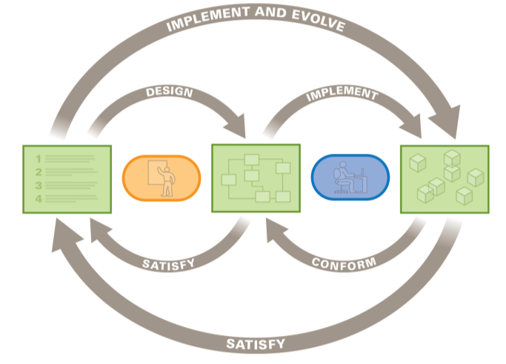
The Big Picture – Your Input
Creation of:
Requirements
Use Cases
QA Scenario
BUSINESS AND
MISSION GOALS
ARCHITECTURE
SYSTEM
Evaluation:
Presented solution fulfills the requirements

Slide 33

What the User Really Wants

Slide 34
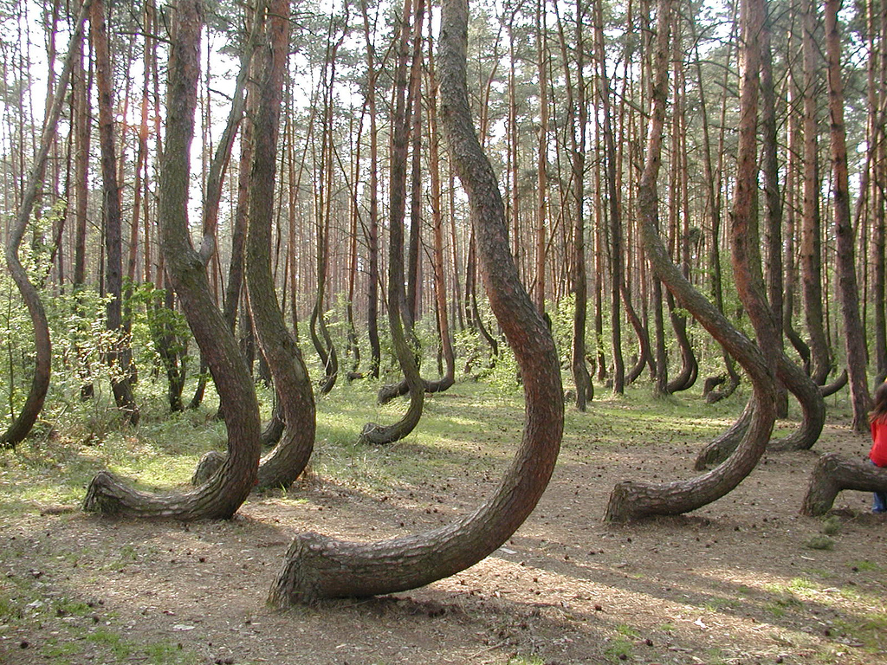
Questions?

